Slide 1
Structure of Fibonacci heaps, potential function
By
Mr. GURURAJ
Assistant Professor-Selection Grade
Department of Computer Science & Engineering
M.I.T Manipal

Slide 2
A Fibonacci heap is a collection of rooted trees that are min-heap ordered. That is, each tree obeys the min-heap property: the key of a node is greater than or equal to the key of its parent. Figure 19.2(a) shows an example of a Fibonacci heap.
each node x contains a pointer x.p to its parent and a pointer x.child to any one of its children. The children of x are linked together in a circular, doubly linked list, which we call the child list of x. Each child y in a child list has pointers y.left and y.right that point to y’s left and right siblings, respectively. If node y is an only child, then y.left = y.right = y. Siblings may appear in a child list in any order.

Slide 3
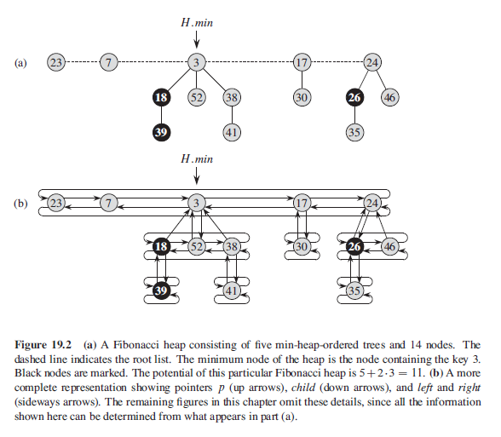

Slide 4
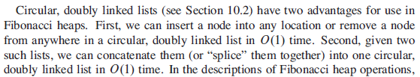
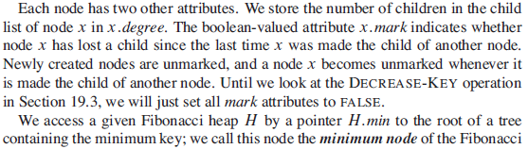
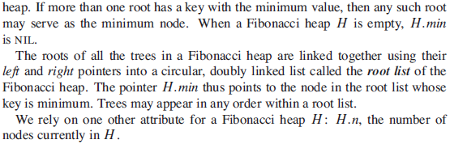

Slide 6
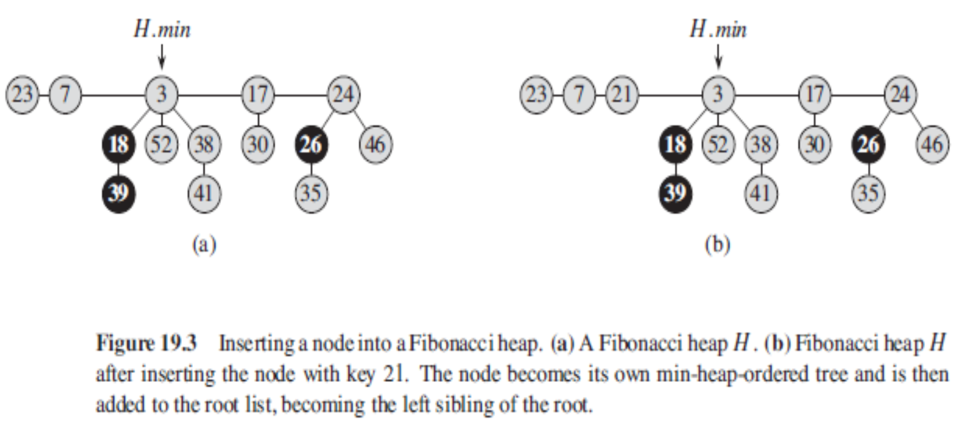

Slide 7
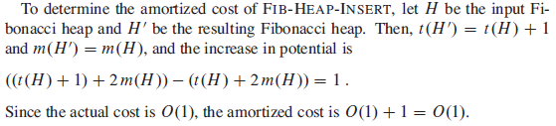

Slide 8
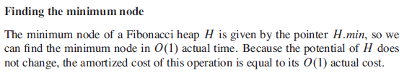
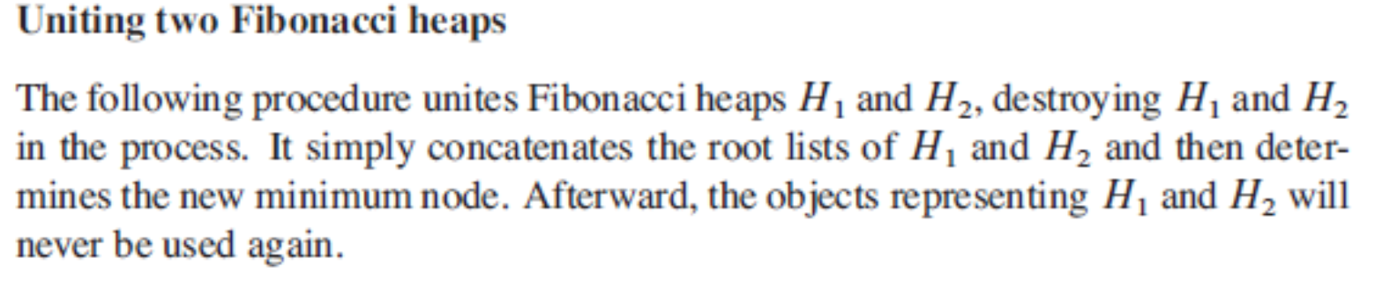

Slide 9
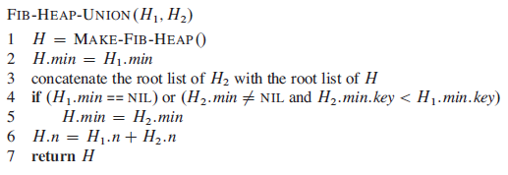
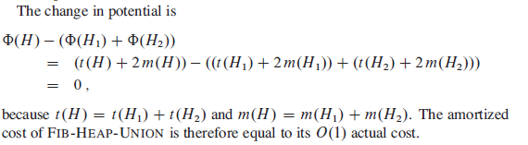

Slide 10
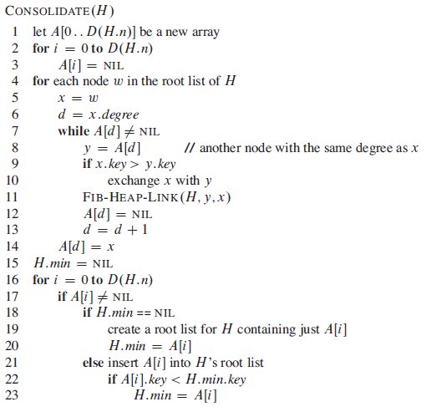
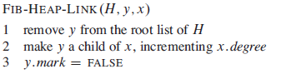

Slide 11
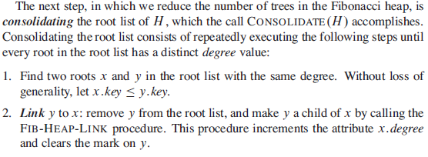
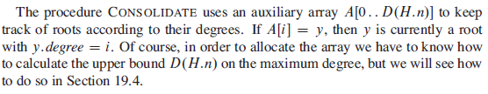

Slide 12
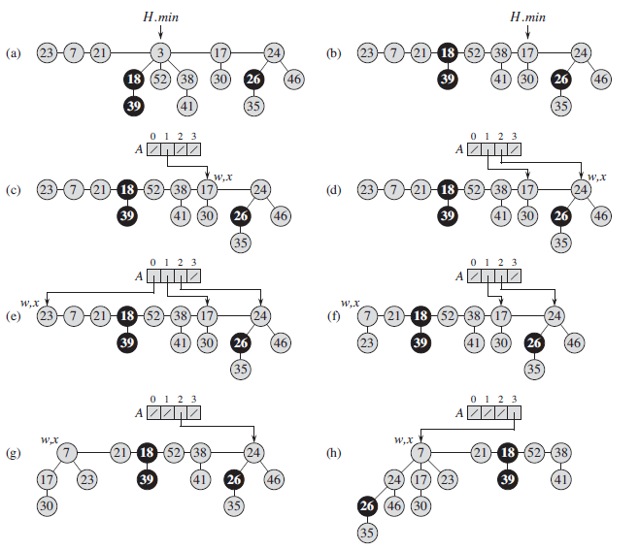

Slide 13
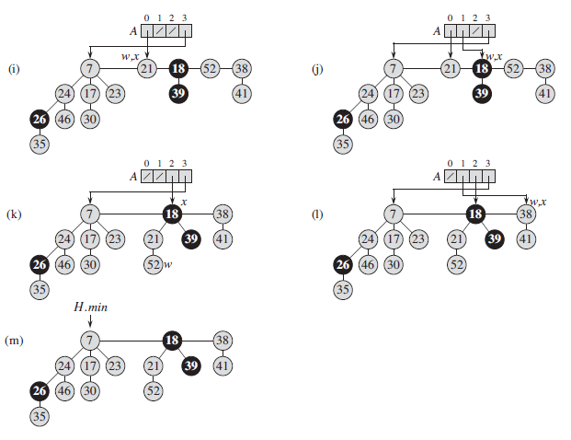

Slide 15
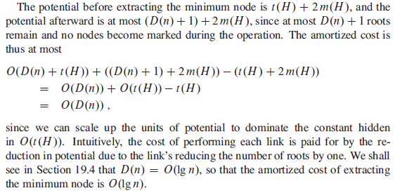

Slide 16
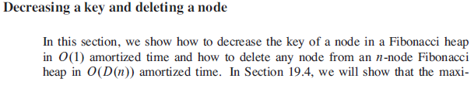
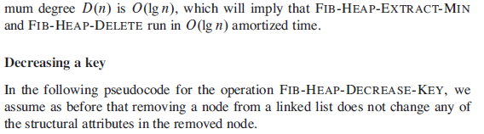

Slide 17
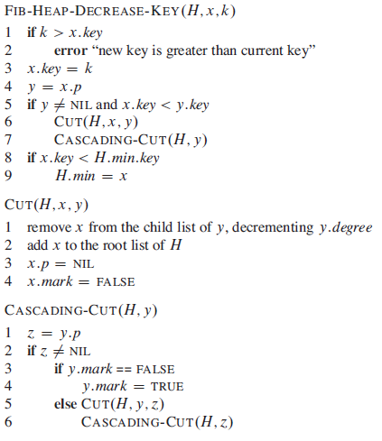
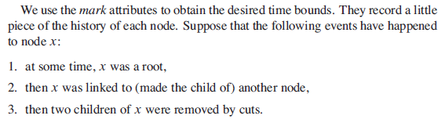

Slide 18
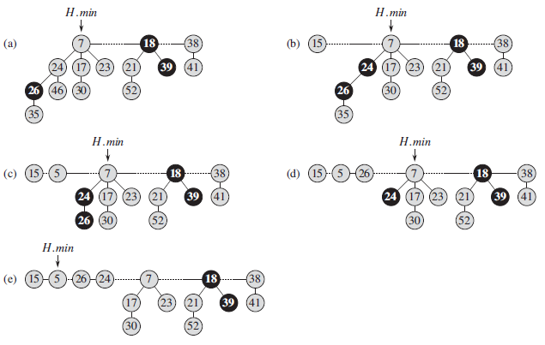
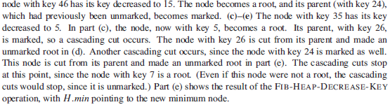

Slide 20
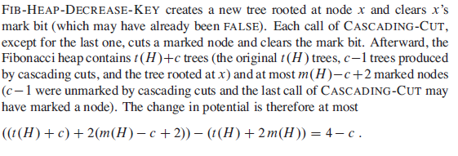
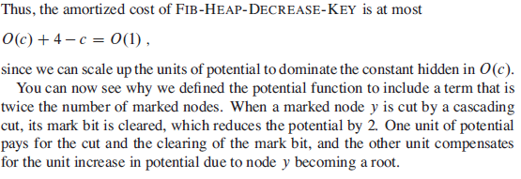

Slide 21
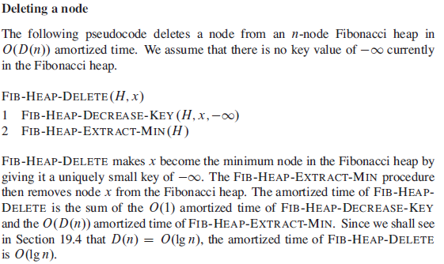

Slide 22
